Slide 1

Entertainment localized
मनोरञ्जन आफ्नै भाषामा

Slide 2

Movies
Most popular art form
Universal
Cross-cultural
“A reflection of society” –Tom Sherak, ex president of AMPAS 2009 - 2011

Slide 3

Business of movies
Total global worth: $136 Billion in 2018
2,577~ movies per year
Indian movie industry: 1800~

Slide 4
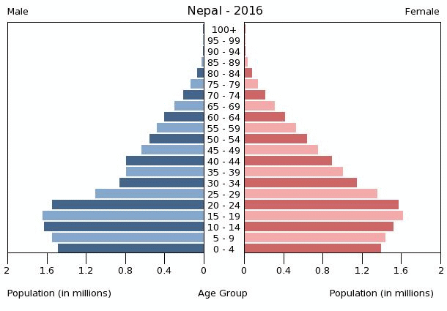
7,626,124
MgoingPopulation:
Source: CIA World Factbook

Slide 5



The Big Idea
=
Conduct psychological profiling of customers and match them against each other

Slide 6
Myers-Briggs Personality Types
ESFP
ISFJ
ESTP
ISTJ
And many more…

Slide 7
MATCHING PERSONALITIES examples:
ISFJ ⬄ ESFJ, ISFP
ESFP ⬄ ESFJ, ESTP
XXX..X
XXX.X#X
ISTJ ⬄ INFJ, ISFJ
XX.X##X

Slide 8
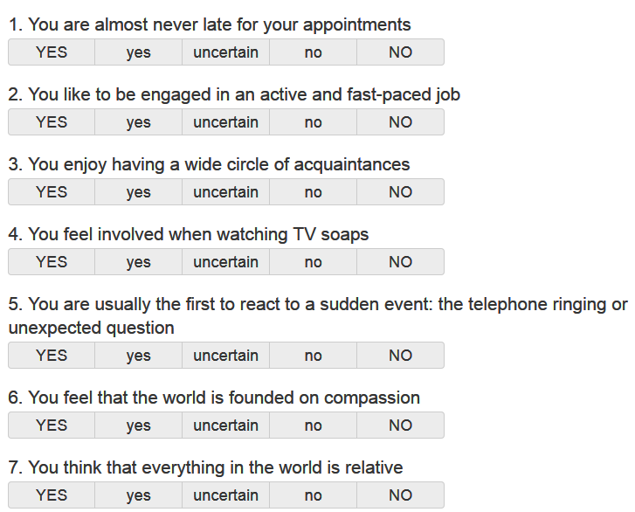
Sample Questionnaire
In-depth questionnaire
Also adding Education, cultural background
Sexual orientation
Type of seek

Slide 9
The Three Dates
Expensive restaurant
Event
Open field

Slide 10

Post 3 dates
Obtain feedback from the daters
If positive, extend to 3 months
Final review after 3 months
Perform Chi-squared test

Slide 11

Logistics
We set the place, the date and time.
We handle everything, from booking to transportation
The client just needs to show up

Slide 12

Employee structure
4 employees:
Receptionist x1
Marketing officer x1
Sales x1
Logistics manager x1

Slide 13

Marketing Strategy
Attractive Website and app
Market aggressively in social media like Facebook and Instagram.
Use referall service: Heavy discount for those who use the referall
Advertise in popular teen/ pre-adult magazines like Wave.
Introduce major schemes during “Valentine’s Day”

Slide 14
Financials
Fixed(monthly):
Company registration: NRs. 5000 /-
4 Employees: NRs. 15000x4
Room: NRs.10000 / month
Electricity and internet: 5000/-
Advertising: 15000/-
Website: NRs. 1500/-
App: NRs. 1000/-
Variable (monthly):
Median taxi fare within valley: NRs. 200 x 4 /-
Median Event fare: NRs. 1000/-
Median Restaurant fare: NRs. 2000/-
Total cost for one couple: 3800
Reserve cost for 10 Couples: 38,000
Total fixed monthly: NRs 97,500 /-
Total yearly approximation 1,626,000/- + 1,00,000 (backup) = NRs. 1,726,000/- ~ 18,00,000/-

Slide 15
Capital Plan
1 lakh each by owners i.e. 1 x 6 = 6 lakhs
Investors: 12lakhs

Slide 16
Pricing
Total price for service: NRs. 10,000/- for one couple (5000 each).
Website registration: NRs. 150/-
Demand citizenship
Photograph

Slide 17


Projection
First Year
Target: 10 dates/month
Yearly:=> 120
Cost: (97,500 + 38000)*12 =>1,626,000
Expected Inflation: 5%
Total cost: 17,07,300
Total revenue: 10000 * 120 =
120,000
Profit = -507300
Second Year
Target: 20 dates/month
Yearly:=> 240
Total cost: (97,500+76000)*12
Expected Inflation: 6%
Total cost: 2,206,920
Total revenue: 10,000 * 240 = 2,400,000
Profit = 193,080
Third Year
Target: 30 dates/month
Yearly:=> 360
Total cost: (97500 + 114000)*12 =>2,538,,000
Expected Inflation: 6.5%
Total cost: 2702970
Total revenue: 10,000 * 360 = 3,420,000
Profit = 717,030

Slide 18
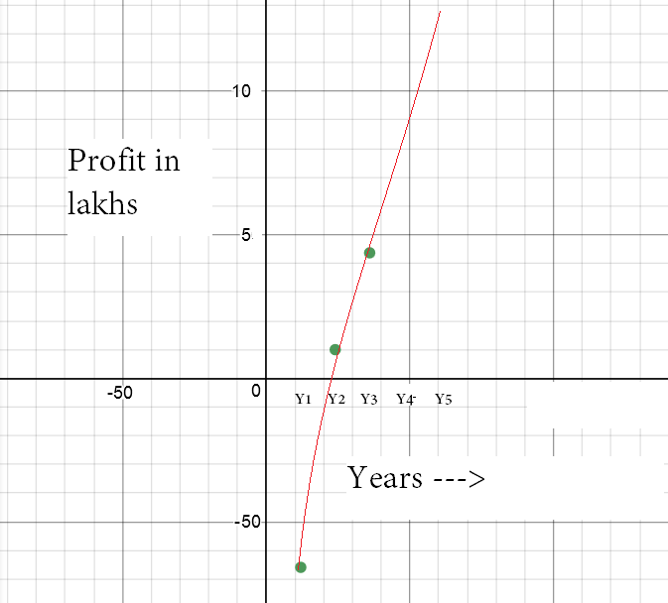
contd.
Steep growth.
Expected profit in 5th year: 13lakhs.

Slide 19
Feasibility
No other such service in Nepal
Some websites, but nothing like this
Easy and cheap to establish
Appeal to young people looking for courtship
No need to buy expensive tools

Slide 20
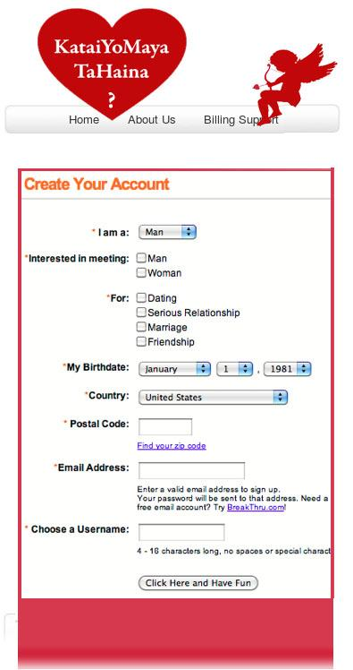
Mobile App concept.
Design applicable for both iPhone and Android
Place your screenshot here

Slide 21
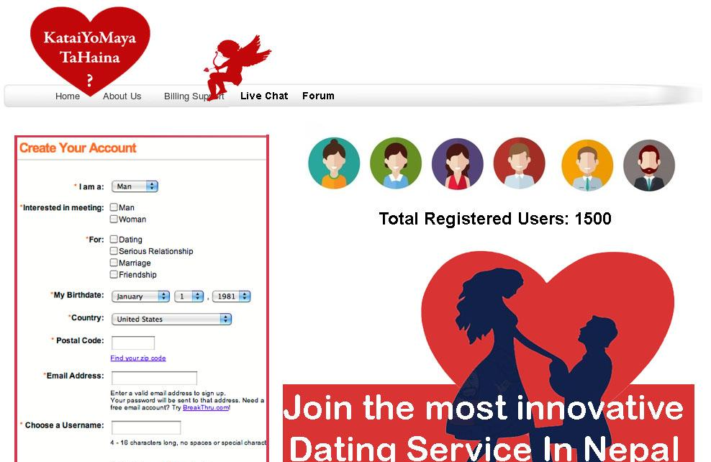
DESKTOP PROJECT
Chat functionality
Profile explorer
In-depth search features
Place your screenshot here

Slide 22

THANKS!
Any questions?
Abhishek Tandukar
Shisir Gurung
Prajwal Yongya
Hitesh Jain
Dravya Chaudhary
Meenal Bansal

Slide 23
References:
“MBTi Basics” Test: https://www.myersbriggs.org/my-mbti-personality-type/mbti-basics/home.htm?bhcp=1
Nepal Inflation Rate: 2012-2022: https://www.statista.com/statistics/422594/inflation-rate-in-nepal/
MBTi and Matching Relationships: https://www.massmatch.com/MBTI-2.php
Nepal Census 2016 - CIA World Facbook: https://www.cia.gov/library/publications/resources/the-world-factbook/geos/np.html

